Slide 1
Healthcare Delivery System
Foundation Standard 3
3.11 Understand the healthcare delivery system (public, private, government and non-profit)

Slide 2
The Healthcare Delivery System
10% of all jobs in America are in health care
More than 200 different health careers
Medical model (Western medicine) assumes that illness and disease require treatment
Recently, some movement toward wellness model – the prevention of disease and maintenance of well-being

Slide 3
HOSPITALS
Can be public or private
Private hospitals can be for profit or non-profit
Many different types and classifications
General hospitals treat a wide variety of illnesses and ages
Joint Commission on the Accreditation of Healthcare Organizations (JCAHO) – helps hospitals maintain quality of care, establishes guidelines for the operation of hospitals, conducts inspections to ensure that standards are being met.

Slide 4
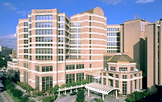
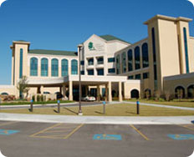
Specialty Hospitals
Specific conditions, age groups, or other ways of grouping patients
For example:
Cancer hospitals
Pediatric hospitals
Psychiatric hospitals
Rehabilitation centers

Slide 5
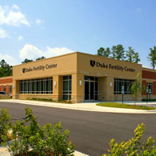
Ambulatory Facilities
Also called “outpatient services” – they often provide diagnostic and treatment services that were previously performed in hospitals
Surgical clinics (surgicenters) outpatient surgery
Urgent care centers
Outpatient clinics
Optical centers
Genetic counseling centers (fertility clinics)

Slide 6
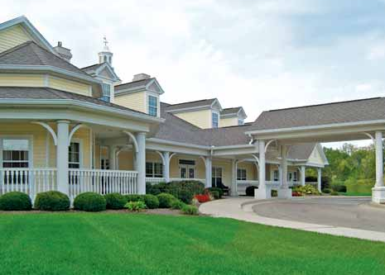
Long Term Care Facilities
Mainly care for elderly patients (residents)
May also care for individuals with disabilities or handicaps
Residential care (nursing homes) – basic physical care
Extended care (skilled nursing) facilities – provide skilled nursing care and rehabilitation services
Assisted (independent) living facilities – provide basic services (meals, housekeeping, etc.) and basic medical care.

Slide 7
Home Health Care
Became more common in late 1980s – now an area of tremendous growth
Nurse or other skilled professional visits patient in his/her home to provide treatment/education
Less expensive than admission to hospital or long term care facility
States require licensing of home health agencies to assure the quality of care

Slide 8
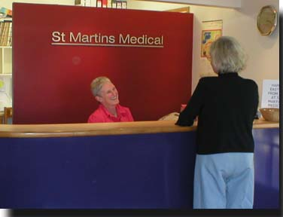
Medical and Dental Offices
Vary from small (one doctor) to large complexes with multiple specialties and other healthcare professionals
Some treat a wide variety of illnesses and conditions, others specialize

Slide 9
Mental Health Services
Counseling centers
Psychiatric clinics and hospitals
Chemical (drug and alcohol) abuse treatment centers
Physical abuse treatment centers, dealing with child abuse, spouse abuse and elderly abuse

Slide 10
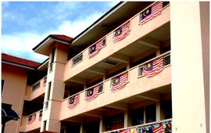
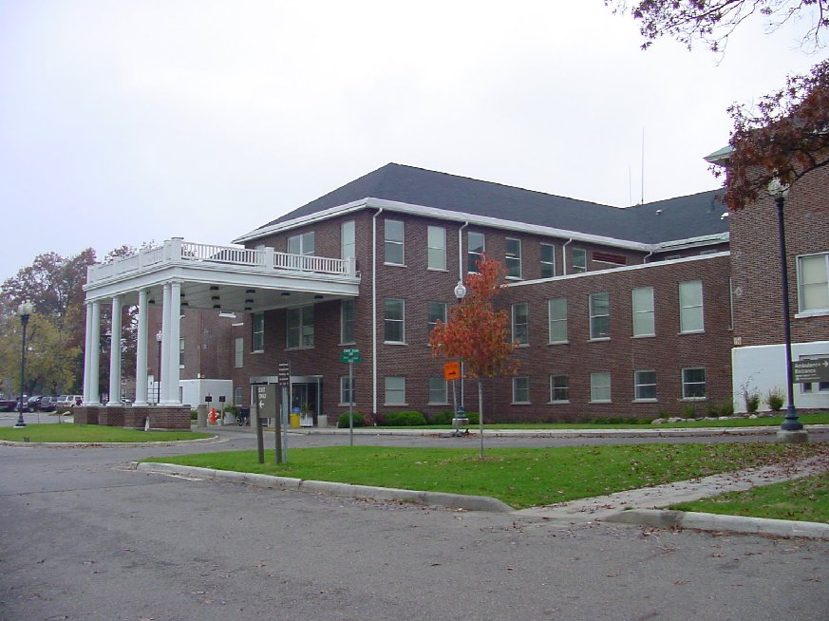
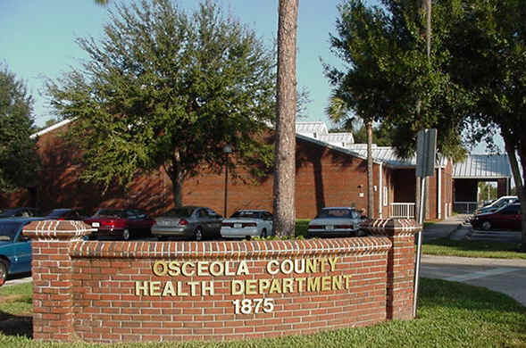
GOVERNMENT AGENCIES
Can be at local, state, national and international levels
Services are tax supported
Veterans Administration Hospital

Slide 11
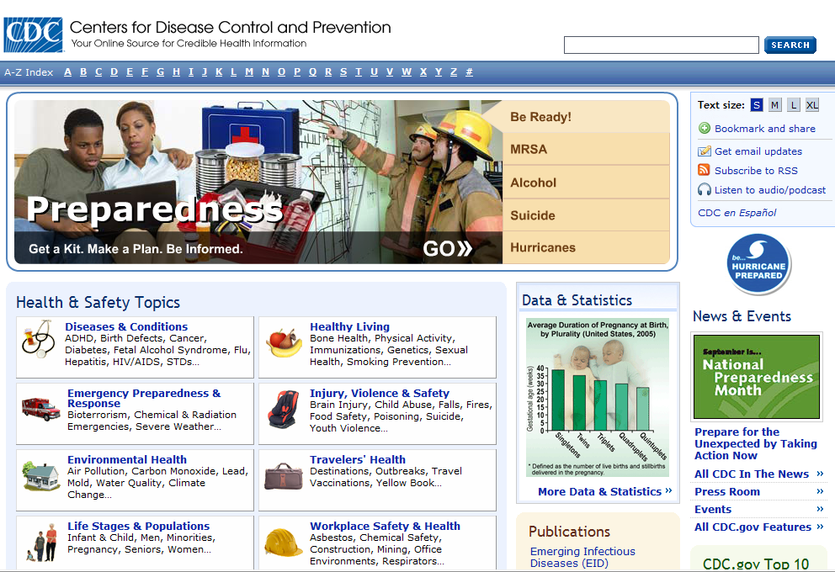
Centers for Disease Control and Prevention (CDC)
U.S. Department of Health and Human Services
Concerned with cause, spread and control of disease, and other health and safety issues, in populations
www.cdc.gov

Slide 12
Food and Drug Administration (FDA)
Federal agency
Responsible for regulating food and drug products sold to the public
www.fda.gov

Slide 13
World Health Organization (WHO)
International agency
Sponsored by United Nations
Compiles disease statistics, promotes healthy living, and investigates serious health problems throughout the world
www.who.int

Slide 14
Occupational Safety and Health Administration (OSHA)
Part of the U.S. Department of Labor
Establishes and enforces standards that protect workers from job-related injuries and illnesses
www.osha.gov

Slide 15
Public Health System (Health Departments)
Part of the U.S. Department of Health and Human Services
Provide services to states and local communities
Examples of services
Immunizations
Environmental health and sanitation
Collection of health statistics and records
Health education
Clinics for health care and prevention

Slide 16
Veterans Administration
Federally supported
Hospitals and other services
Care for veterans who served in the armed forces
www.va.gov

Slide 17
NON-PROFITS
Also called voluntary agencies
Most deal with specific diseases or groups of diseases
They provide funding for research, promote education, and services for victims of disease.
They also influence laws, create standards, and educate health professionals

Slide 18
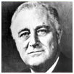
March of Dimes
Founded by President Franklin D. Roosevelt in 1938
He was a victim of paralytic poliomyelitis
Initial goal of March of Dimes – care of polio victims, carry out research, develop vaccine
Today – focus on preventing birth defects and reducing infant mortality
www.marchofdimes.com

Slide 19
American Heart Association (AHA)
Founded in 1915 by a group of cardiologists
Mission is to reduce disability and death from cardiovascular disease and stroke
Research, education and community programs
www.americanheart.org

Slide 20
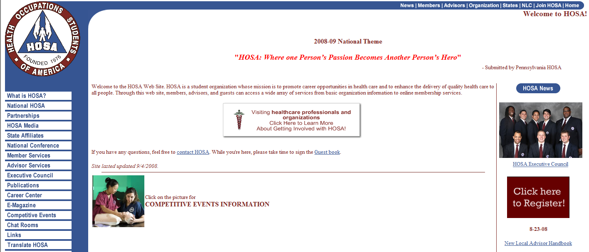
HOSA
Non-profit student organization
Promotes career opportunities in health care
Over 120,000 members in 47 states and Puerto Rico
www.hosa.org

Slide 21
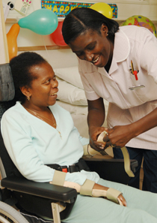
Hospice
Hospice movement began in England, rapidly growing in United States
Provides palliative care (relieves but does not cure) to dying patients and their families
Involves healthcare professionals and volunteers
Emphasis is to make patient’s last days as pain-free and meaningful as possible

