Slide 1
Chapter 21
Reproductive System

Slide 2
Functions of the
Reproductive System
Accomplish reproduction
    Creation of new life
Manufacture hormones
    Females – estrogen and progesterone
    Males – testosterone

Slide 3
Fertilization
Coitus
Sperm production
Corona radiata
Fertilization
    Zygote
DNA

Slide 4
Reproductive System
Phases of fetal development
Differentiation of reproductive organs
Organs of reproduction

Slide 5
Female Reproductive System
Ovaries
Fallopian tubes
Uterus
Vagina
External female genitalia
Breasts

Slide 6
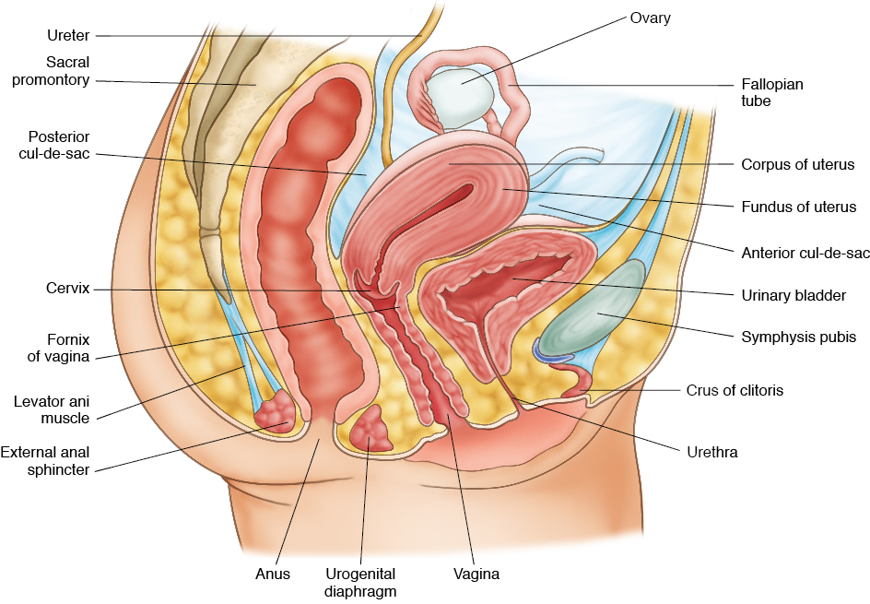
Female Reproductive
System Structures
© 2014 Cengage Learning.

Slide 7
Menstrual Cycle
Follicle stage
Ovulation stage
Corpus luteum stage or luteal phase
Menstruation stage

Slide 8
Menopause
When monthly menstrual cycle comes to an
end
Commonly occurs between 45 and 55 years
of age
End of childbearing
Anatomical changes

Slide 9
Male Reproductive System
Testes and epididymis
Descent of the testes
Scrotum
Ductus deferens, seminal vesicles, and
ejaculatory ducts

Slide 10
Male Reproductive System
Penis
Prostate gland
Bulbourethral glands
Semen
Erection and ejaculation
Impotence/erectile dysfunction

Slide 11
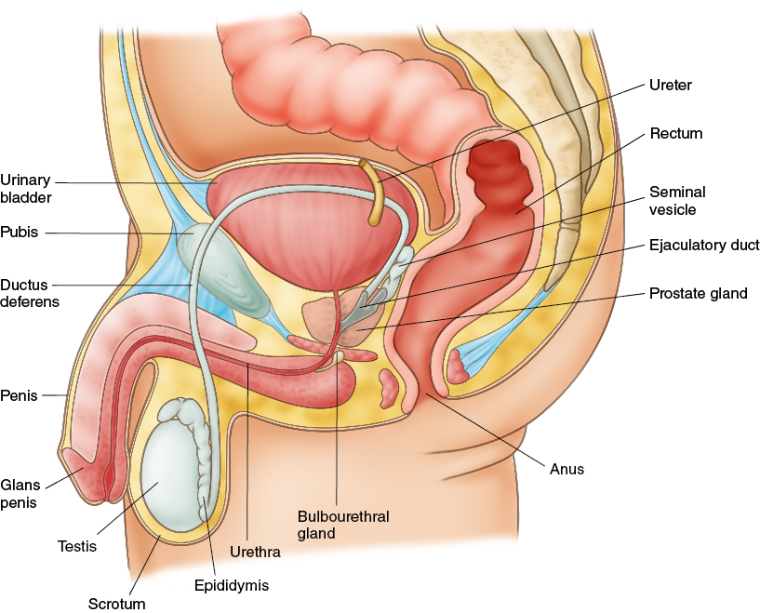
Male Reproductive
System Structures
© 2014 Cengage Learning.

Slide 12
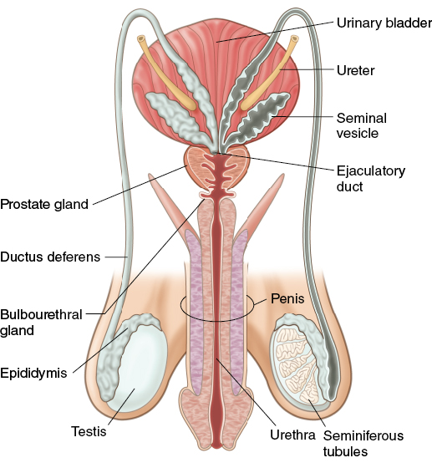
Male Reproductive
System Structures
© 2014 Cengage Learning.

Slide 13
Contraception
Religious and ethnic group concerns
Abstinence
Reasons for avoiding pregnancy
Methods of contraception

Slide 14
Infertility
When conception does not occur after trying for one year
Causes of infertility
Fertility drugs

Slide 15
Infertility
In vitro fertilization (IVF)
Gamete intrafallopian transfer (GIFT)
Zygote intrafallopian transfer
Donor eggs and embryos

Slide 16
Effects of Aging – Female
Menopause
Decrease in estrogen and progesterone
production
Narrowing of vaginal opening, loss of tissue
elasticity, and a decrease in vaginal secretions
Atrophic changes

Slide 17
Effects of Aging – Male
Sexual response is slower
Obtaining and maintaining an erection
becomes more difficult
Prostate gland size increases, testes decrease
in size, and sperm level decreases
Testosterone level decreases
Viscosity of seminal fluid diminishes

Slide 18
Disorders – Female
Reproductive System
Amenorrhea
Premenstrual syndrome (PMS)
Dysmenorrhea
Menorrhagia
Endometriosis

Slide 19
Disorders – Female
Reproductive System
Fibroid tumors
Breast tumors
Endometrial cancers
Ovarian cancer
Cervical cancer

Slide 20
Infections – Female
Reproductive System
Pelvic inflammatory disease (PID)
Salpingitis
Toxic shock syndrome
Vaginal yeast infections

Slide 21
Disorders – Male
Reproductive System
Epididymitis
Orchitis
Prostatitis
Benign prostatic hypertrophy (BPH)
Prostate cancer

Slide 22
Sexually Transmitted
Diseases (STDs)
Also known as venereal disease
Transmission
Many have no symptoms
Prevention
Chlamydia

Slide 23
Sexually Transmitted
Diseases (STDs)
Genital warts or human papillomavirus
(HPV)
Gonorrhea
Genital herpes
Syphilis
Trichomoniasis vaginalis

Slide 24
Human Growth and Development
Infancy
Toddler
Preschool
School age
Adolescence

Slide 25
Human Growth and Development
Early adulthood
Middle adulthood
Older adulthood

