Slide 1
Chapter 6
Skeletal System

Slide 2
Skeletal System Functions
Support
Protect
Movement and anchorage
Mineral storage
Hemopoiesis

Slide 3
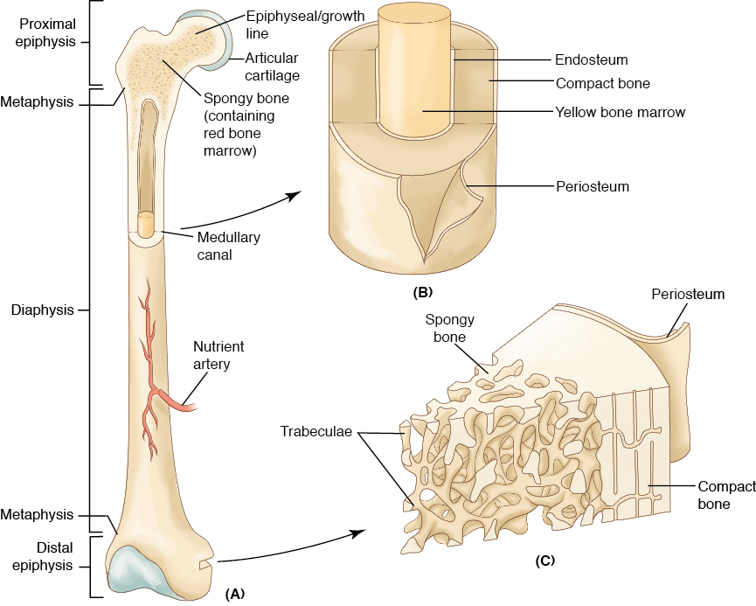
Structure and Formation of Bone
© 2014 Cengage Learning.

Slide 4
Structure and Formation of Bone
Osteocytes
    Mature bone cell
Organic material (flexibility)
    Collagen
    Jellylike material
Inorganic material (hardness and durability)

Slide 5
Long Bones
Shaft or diaphysis
Each end is the epiphysis
    Covered by articular cartilage
In the center is the medullary canal
    Yellow bone marrow
    Endosteum (lining of the marrow canal)

Slide 6
Long Bones
Red marrow
    Ends of long bones
    Manufactures red blood cells and some white blood cells
Periosteum
    Covering on the outside of the bone

Slide 7
Growth
Grow in length
Ossify from the center outward
Osteoblasts
Osteoclasts

Slide 8
Growth
Growth stops when all the epiphyseal
cartilage is ossified
Females grow until about 18 years of age
Males grow until about 20-21 years of age

Slide 9
Bone Types
Long bones
Flat bones
Irregular bones
Short bones

Slide 10
Skeletal System
Axial skeleton
    Skull, spinal column, ribs, sternum, and hyoid bone
Appendicular skeleton
    Upper and lower extremities

Slide 11
Axial Skeleton
22 bones of the skull
14 facial bones
Spinal column (vertebra)
Ribs and sternum

Slide 12
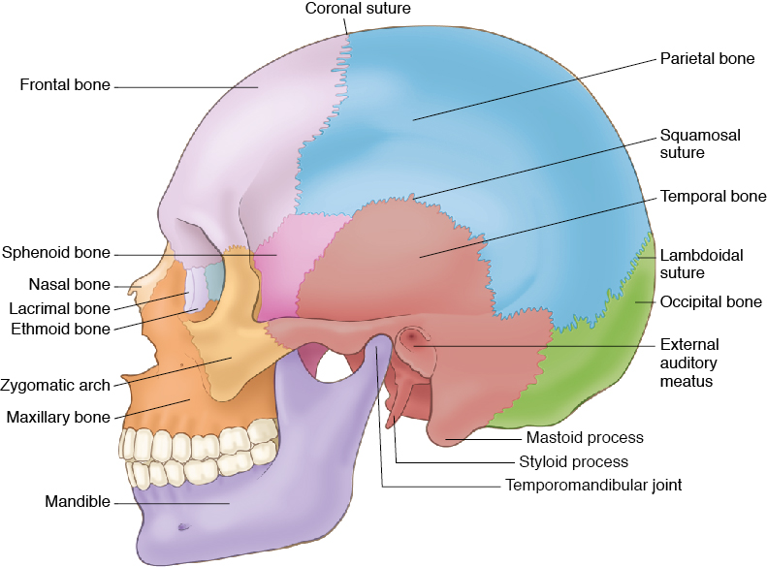
The Skull
© 2014 Cengage Learning.

Slide 13
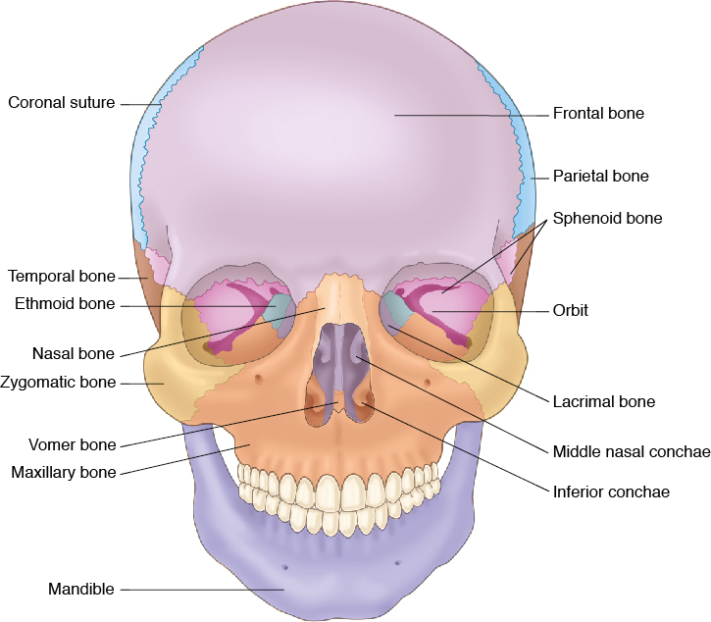
The Skull
© 2014 Cengage Learning.

Slide 14
Appendicular Skeleton -
Upper Extremities
Shoulder girdle
Arm
Hand

Slide 15
Appendicular Skeleton -
Lower Extremities
Pelvic girdle
Upper leg
Lower leg
Ankle
Foot

Slide 16
Joints
Called articulations
    Points of contact between two bones
Diarthroses (movable) joints
Amphiarthroses (partially movable) joints
Synarthroses (immovable) joints

Slide 17
Joints
Articular cartilage
Articular capsule
    Synovial membrane
    Synovial fluid
    Synovial cavity
Bursa sacs

Slide 18
Diarthroses Joints
Movable joints
Ball-and-socket joints
Hinge joints
Pivot joints
Gliding joints

Slide 19
Amphiarthroses Joints
Partially movable joints
Cartilage between their articular surfaces
Examples:
  Ribs to the spine
  Symphysis pubis

Slide 20
Synarthroses Joints
Immovable joints
Connected by tough, fibrous connective tissue
Example:
  Adult cranium
Cranial joints are called sutures

Slide 21
Types of Motion
Flexion
Extension
Abduction
Adduction
Circumduction

Slide 22
Types of Motion
Rotation
Promation
Supination

Slide 23
Aging of the Bones and Joints
Bone mass and density decline
External surfaces of the bones thicken
Intervertebral cartilage disks shrink
Center of balance is altered

Slide 24
Aging of the Bones and Joints
Joints less mobile
Increased rigidity and decreased flexibility
Fear of falling

Slide 25
Disorders of the Bones and Joints
Fracture
    Greenstick
    Closed/simple
    Open/compound
    Comminuted

Slide 26
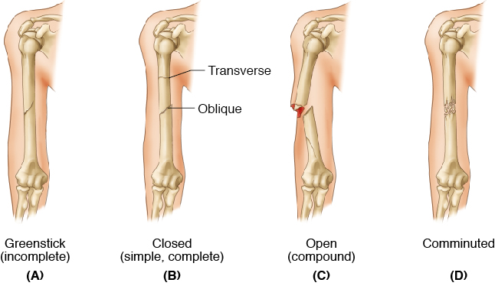
Disorders of the Bones and Joints
© 2014 Cengage Learning.

Slide 27
Repairing Fractures
Closed reduction
Open reduction
Traction

Slide 28
Other Bone and Joint Injuries
Dislocation
Sprain
Hammer toe
RICE Treatment

Slide 29
Diseases of the Bones
Arthritis
    Rheumatoid arthritis
    Osteoarthritis
Gout
Rickets

Slide 30
Other Bone and Joint Injuries
Slipped (herniated) disc
Whiplash injury

Slide 31
Abnormal Curvatures of the Spine
Kyphosis (hunchback)
Lordosis (swayback)
Scoliosis

Slide 32
Other Disorders
Osteoporosis
Osteomyelitis
Osteosarcoma

