Slide 1
Everywhere you look
Health Science touches your life

Slide 2
Stop and look around…
Chances are you have been to the doctor or dentist lately. Your grandmother may have recently stayed in the hospital. New developments in biotechnology may have affected the food you ate for breakfast today.

Slide 3
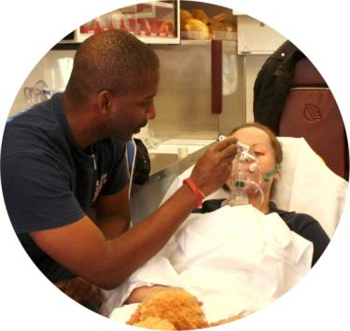
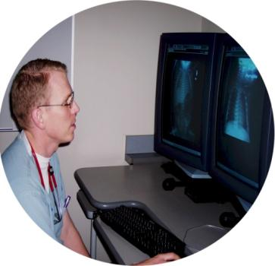
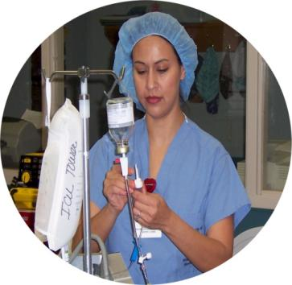
The World of Health Science…
There are many opportunities within the world of health science. Interested students need to have a solid background in math and science as well as communication, technical and teamwork skills. Education and training can be obtained in high schools, community colleges, universities and technical schools. Through the training programs, learners gain knowledge and skills that lead to workplace learning experiences like job shadowing and internships.

Slide 4
Employment Outlook
Health Science is the largest and fastest growing industry in the United States. The health care industry employs over 10 million workers in more than 200 careers.

Slide 5
The health science career cluster is divided into 5 career pathways. Pathways are grouped by common knowledge and skills required for occupations in these career fields. Each pathway provides instruction as a basis for success in an array of careers and educational pursuits.
Career
Pathways

Slide 6
The Five Pathways
Therapeutic Services Diagnostic Services
Health Informatics Support Services
Biotechnology Research and development

Slide 7
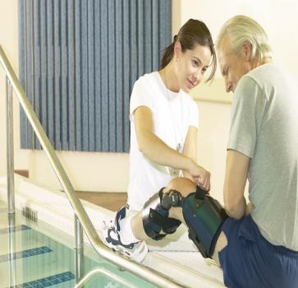
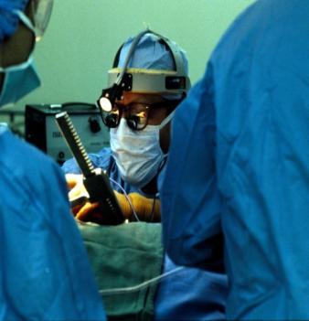
Therapeutic Services
Careers in therapeutic services are primarily focused on changing the health status of the patient over time. Health professionals work directly with patients and may provide care, treatment, counseling and health education information.

Slide 8
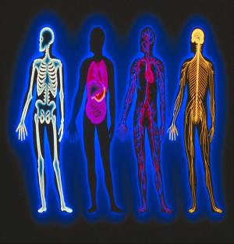
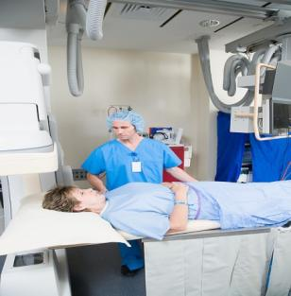
Diagnostic Services
Careers in diagnostic services use tests and evaluations that aid in the detection, diagnosis and treatment of diseases, injuries or physical conditions.

Slide 9
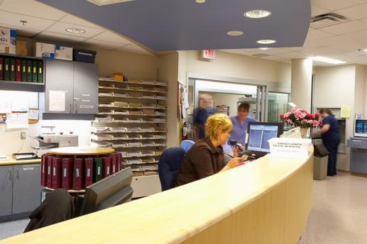
Health Informatics
The health informatics pathway offers a wide range of career opportunities. Careers range from health care administrators who manage health care agencies to individuals responsible for managing patient data, financial information and computer application related to health care processes and procedures.

Slide 10
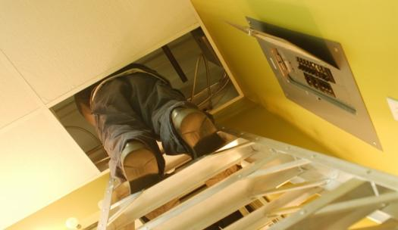
Environmental Support Services
Careers in the support services provide a therapeutic environment for the delivery of health care. Career opportunities range from entry level to management including technical and professional careers.

Slide 11
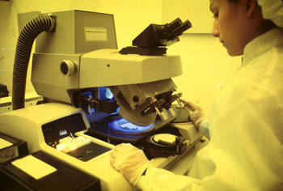
Biotechnology Research and Development
Careers in the biotechnology research and development pathway involve bioscience research and development as it applies to human health. These are scientists who may study diseases to discover new treatments, invent medical devices or improve the accuracy of diagnostic tests.

Slide 12
The Future…
Health science will bring better health care
Outstanding employment opportunities

Slide 13
Secondary Education
Refers to basic preparation in high school
Includes the sciences, social studies, English, and math
Keyboarding and computer skills are necessary

Slide 14
Post-secondary
Education received after gradation from high school
Includes education in technical schools, community colleges, and universities

Slide 15
On the Job Training
Employee training at the place of work while he or she is doing the actual job.
Usually a professional trainer or sometimes an experienced employee serves as the course instructor using hands-on training often supported by formal classroom training.

Slide 16
EDUCATIONAL REQUIREMENTS
Depend on many factors
Can vary from state to state
Some basic standards do exist

Slide 17
TYPES OF DEGREES
Associate
Bachelor’s
Master’s
Doctoral

Slide 18
ASSOCIATE
Awarded by technical or community colleges
Requires completion of prescribed two-year course of study

Slide 19
BACHELOR’S
Awarded by college or university
Requires completion of prescribed course of study that usually lasts for four or more years

Slide 20
MASTER’S
Awarded by college or university
Requires completion of one or more years beyond a bachelor’s degree

Slide 21
DOCTORATE
Awarded by college or university
Requires completion of two or more years beyond a bachelor’s or master’s degree
Some require four to six years of additional study

Slide 22
Continuing Education
Continuing education means the variety of forms of learning experiences, including, but not limited to, lectures, conferences, seminars, workshops, grand rounds, video conferencing, and distant learning technologies after adults have left the formal education system.

Slide 23
CERTIFICATION, REGISTRATION, LICENSURE
Methods used to ensure skill and competency of health care personnel and protect consumer or patient

Slide 24
Certification, Licensure, Registration
Government agency authorizes individuals to work in a given occupation
Varies from state to state
Completes an approved educational program, pass a state board test, and maintain certain standard to obtain and retain licensure or certification

Slide 25
Examples
Certified laboratory technician
Certified medical assistant
Registered dietitian
Registered Nurse
Physicians
Dentists

Slide 26
MULTICOMPETENT OR MULTISKILLED WORKER
New trend in health occupations
Workers perform in a variety of occupations
Eliminates need for employing specialist for every aspect of care

Slide 27
EXAMPLES
Combine ECG or EKG technician and EEG technologist
Combine basic skills of radiology, medical laboratory and medical assistant
At times, workers trained in one field receive additional education to work in second or third occupation

Slide 28
ENTREPRENEUR
Individual who organizes, manages, and assumes the risk of a business
Opportunity available in many health occupations
However, even as entrepreneurs, many health professionals must still work under the direction or guidance of doctors

Slide 29
ENTREPRENEUR
Involves risks and requires certain level of education and ability
Satisfying to individual who is well motivated, self-confident, responsible, creative, and independent
Example: physical therapist may work as a hospital employee or work independently in home health industry

Slide 30
Alternative or Complimentary Medicine
Medical practices, and products that are not considered to be part of conventional medicine
Tend to be strongly prevention-oriented and place a high value on the body's natural ability to heal itself
Acupuncture Practitioner
Chiropractor
Massage Therapist
Naturopathic Doctor

Slide 31
Resources
Health Careers in Georgia
Explore Health Careers
Lifeworks
Career One Stop

