Slide 1
The History of Healthcare

Slide 2
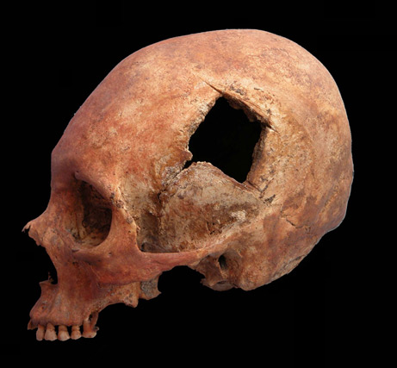
Prehistory and the Ancient World
Believed that illness and disease was caused by supernatural spirits and demons.
Herbs and plants were used as medicine
Sometimes performed surgery such as trepanation (boring a hole in the head)
http://www.pbs.org/wgbh/nova/ancient/inca-skull-surgery.html

Slide 3
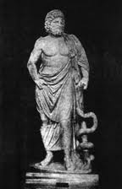
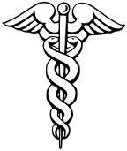
Religion in Medicine
Asclepius was the Greek God of Healing
People went to his temple to pray for cures
His symbol was a snake
Other people during this time used Healers or nature for cures

Slide 4
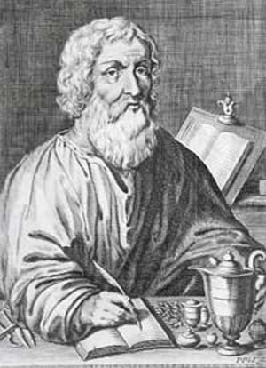
Hippocrates
Is known as the Father of Medicine
Practiced and taught medicine around 400B.C. in Greece
Recorded signs and symptoms of many diseases
He and his students followed a strict ethical code, swearing to maintain patient privacy and
to never harm someone on purpose.
Doctors still swear by this oath today,
called the Hippocratic Oath.

Slide 5
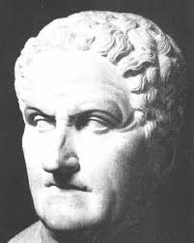
Galen- 200A.D.
Was also Greek
Was appointed as a physician to the gladiators
Galen documented the importance of the spinal cord to limb movement.
Cured breathing difficulties by performing tracheotomies, still used today.
Dissected animals to learn more about
the human body

Slide 6
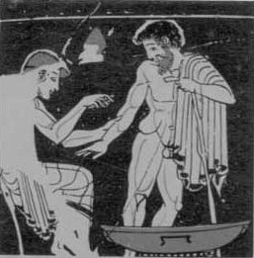
Galen believed in the four humors- blood, phlegm, black bile, and yellow bile.
He believed an imbalance in any one of these humors resulted in sickness of the body.
These humors were balanced by
bloodletting.
http://www.pbs.org/wnet/redgold/media_players/basics_humorsT1.html

Slide 7
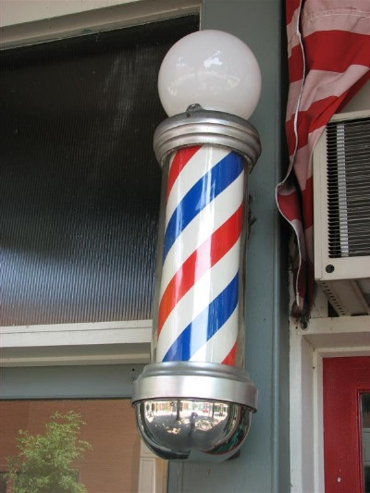
Middle Ages 500A.D.-1500
Reason replaced spiritual and superstitious causes for illness.
Barber-surgeons- besides cutting hair,
they also treated cataracts, amputated
limbs, and burned the stumps of
limbs to seal the blood vessels.
Barber shop symbol-
Regulation of medical care began-
Physicians were licensed after formal
training.
http://www.youtube.com/watch?v=JVQO0a4mMWs

Slide 8
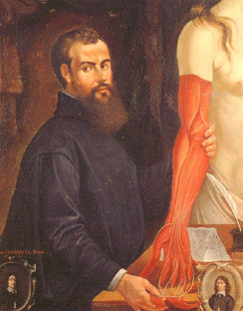
The Renaissance 1500-1700
Artists Michaelangelo and Leonardo da Vinci used dissection to be able to draw the human body more realistically.
The printing press allowed knowledge to be spread to others.
Andreas Vesalius published the first
book on Human Anatomy. He proved
Galen wrong.
The microscope was invented

Slide 9
The Industrial Revolution 1700-1900
Many changes came in healthcare due to the introduction of machines.
Stethoscopes , better microscopes so that blood cells and bacteria could be seen.
Joseph Lister insisted on cleaning hands and instruments before moving to another patient. We call this MEDICAL ASEPSIS. He was made fun of.
The use of ether to anesthetize began so that surgery could be painless.

Slide 10
Modern Times
Rapid growth in healthcare
Antibiotics
X-ray’s
Cancer treatment
Organ transplants
Medicines
computers

