Slide 1
Muscular System
Outline

Slide 2
MMuussccuullaarr SSyysstteemm
1.13 Analyze the basic structure and function of the human body –Muscular system.

Slide 3
MMuussccuullaarr SSyysstteemm
There are greater than 600 muscles in the human body. There are three distinct types of muscles – skeletal, cardiac, and smooth (Visceral).

Slide 4
A. Functions of the Skeletal Muscle :
1.Produce movement: Muscle
contractions pull on tendons and
move the bones of the skeleton.
2. Maintain posture and body
position: Without constant
muscular tension you could not sit
upright without collapsing or
standing without toppling over.

Slide 5
Functions of the Skeletal Muscle :
3. Support soft tissues: The
abdominal wall and the floor of
the pelvic cavity consist of
layers of muscle that support
the weight of visceral organs
and shield internal tissues form
injury.

Slide 6
Functions of the Skeletal Muscle :
4. Guard entrances and exits:
Skeletal muscles guard
openings to the digestive and
urinary tracts and provide
voluntary control over
swallowing, defecation, and
urination.

Slide 7
Functions of the Skeletal Muscle:
5.Maintain body temperature:
Muscle contraction requires
energy, and whenever energy is
used in the body, some of it is
converted to heat. The heat lost
by working muscles keeps the
body temperature in the normal
range.

Slide 8
Four Properties of Muscles
Excitability
Contractibility
Extensibility
Elasticity

Slide 9
Excitability -the ability to respond to stimulation.
Ex: skeletal muscles normally respond to stimulation by the nervous system.
Ex: some smooth muscles respond to circulating hormones.

Slide 10
2. Contractibility - the ability to shorten actively and exert a pull, or tension that can be harnessed by connective tissues.

Slide 11
3. Extensibility- the ability to
continue to contract over a range of resting lengths.
Ex: a smooth muscle cell can be stretched to several times its original length and still contract on stimulation.

Slide 12
4. Elasticity- the ability of a muscle to rebound toward its original length after a contraction.

Slide 13
anatomists often used the Greekwords
Sarkos- (flesh)
Mys-(muscle).

Slide 14
Muscle Vocabulary
Muscle fibers-is the elongated cells of
a muscle.
Striations- light and dark stripes across
the muscle.
Fascicles- dense bundles of muscles.
Voluntary muscles- muscles that you
can consciously control.

Slide 15
Types of Muscle
Skeletal muscle
Visceral or Smooth muscle
Cardiac muscle

Slide 16
Muscle Types
Skeletal- responsible for moving the
body parts, made up of elongated
cells, found in groups called
fascicles, have many nuclei,
surrounded by connective tissue,
contractions can usually be
consciously controlled.

Slide 19
C. Visceral muscle
Smooth muscle- found in organs,
single nuclei, interlace to form
sheets, called involuntary muscles.
Involuntary muscles- most of the
movement cannot be consciously
controlled.

Slide 21
Cardiac muscle
found only in the heart, has striations, is involuntary, only one nuclei per cell

Slide 22
Cardiac Muscle is unique because it has a Pacemaker, a bundle of specialized muscle cells in the upper part of the heart that sends electrical signals through cardiac muscle, causing the heart to beat.

Slide 24
Comparison of Muscle Types
Muscle Type
Skeletal
Cardiac
Smooth
Location
Function
Control Mode
Shape
Characteristics

Slide 25
Comparison of Muscle Types
Muscle Type
Skeletal
Cardiac
Smooth
Attached to bone
Heart
Walls of internal organs + in skin
Location
Movement of bone
Beating of heart
Movement of internal organs
Function
Control Mode
Voluntary
Involuntary
Involuntary
Long + slender
Branching
Spindle shape
Shape
Striated- light and dark bands Many nuclei
Striated One or two nuclei
Non-striated One nucleus (visceral)
Characteristics

Slide 26
Most skeletal muscle are arranged in opposing pairs.
One muscle in a pair moves a limb in one direction, the other muscle moves it in the opposite direction.
Muscles must be attached to bones for leverage so they can PULL!
Muscles can only pull, NEVER push!

Slide 27
Muscles are attached to Bones by Tendons.
Tendons- nonelastic, dense, fiberous connective tissue.
Remember: Bones are connected to other Bones by Ligaments.
Joints- are the place where two or more bones come together.

Slide 28
Skeletal Muscles are attached at both ends.
attachments may be to bones, cartilage, ligaments, tendons, skin or sometimes to each other.

Slide 29
Skeletal muscle
Origin- Origin- is the point where the muscle attaches to the (fixed) or stationary bone or structure
Insertion- is the point where the
muscle attaches to the movable bone or structure.

Slide 30
Skeletal muscle
Belly- the central body of the muscle.
Prime Mover- Produces movement in a single direction.
Antagonist- pulls from the other direction.
Antagonist pairs- muscles with opposite actions
Synergists-muscles that steady or stabilize joint activity

Slide 31
According to Scott and Fong there are 656 skeletal muscles in the human body.
327 antagonistic muscle pairs
2 unpaired muscles
The diaphragm
Orbicularis oris

Slide 32
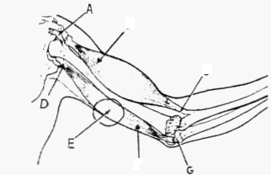
Muscle + Bone Interaction
Let’s review the structures involved in movement at a joint.
A
Ligament
Tendon
Cartilage
Body (Belly)
Origin
Insertion
Contracted muscle
Relaxed muscle
Flexor
Extensor
B
D
C
G
E
C
D
C
B
F
B
F
F

Slide 33
Muscle contractions may be
Isotonic
Muscle contracts and shortens.
Ex: walking, talking, writing
Isometric
Tension in the muscle increases but the muscle does not shorten
Ex: Exercises- tensing abs

Slide 34
F. Muscles must be worked to stay in shape.
When muscles are not exercised the muscles become weak and flaccid.

Slide 35
Muscle tone-even at rest a muscle is always slightly contracted and ready to pull.
Good muscle tone can be achieved through proper nutrition and regular exercise.

Slide 36
Atrophy- muscle shrinkage from disuse.
Hypertrophy- muscle enlargement from overexercising

Slide 37
Muscle Fatigue-the decline in ability of a muscle to generate force.
can be a result of vigorous exercise which can cause the build up of lactic acid in the muscles.
Lactic acid build up can also cause cramps and sore muscles.
HOW DOES IT WORK?
*anaerobic muscle contraction, lactic acid build up, Oxygen debt

Slide 38
Most muscles are named by one of the following rules.
Some even use a combination of the rules.

Slide 39
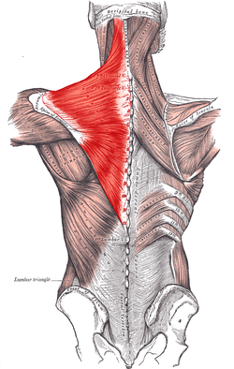
Shape:
deltoid – triangle
Latissimus – wide
teres - round
trapezius – trapezoid
serratus –saw-toothed
orbicularis – circular

Slide 40
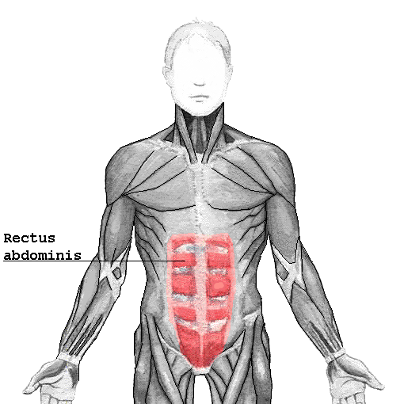
Direction/Orientation:
rectus (straight) –
parallel to the muscle’s long axis
ex: rectus abdominis
transversus (transverse) –
at right angles to the muscle’s long axis
oblique – diagonal

Slide 41
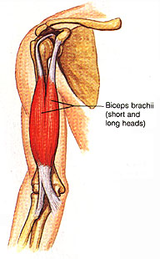
Number of Origins:
biceps – two origins
ex: biceps brachii
triceps – three origins
ex: triceps brachii
quadriceps – four origins

Slide 42
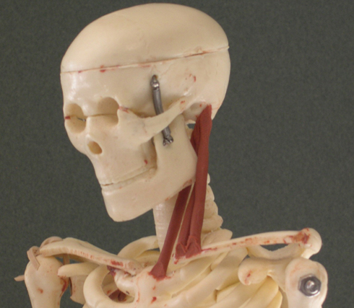
Origin and Insertion:
sterno = sternum
cleiodo = clavicle
mastoid = location on the
temporal bone

Slide 43
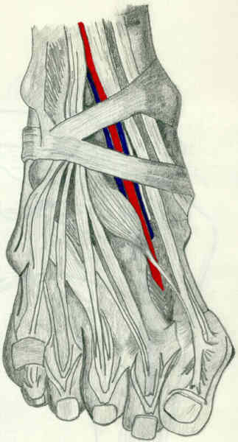
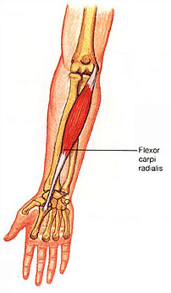
Action:
flexor carpi radialis –
flexes wrist
abductor magnus –
abducts the thigh
extensor digitorum –
extends the fingers
levator –
lifts a structure

Slide 44
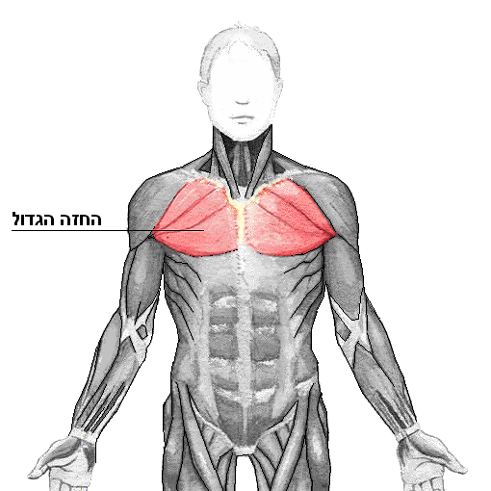
Size:
maximus – largest
minimis – smallest
vastus - huge
longus – longest
brevis – short
major – large
minor – small

Slide 45
Location
frontalis – frontal bone
lateralis – lateral or on the side
tibialis anterior – front of tibia
fibularis longus – near fibula
supra – above
infra – below
sub - underneath

Slide 46
Movements
1 . Adduction
2. Abduction
3. Flexion
4. Extension
5. Rotation
6. Circumduction
7. Inversion
8. Eversion

Slide 47
Biceps Femoris
Hamstrings Semitendinosus
Semimembranosus

Slide 48
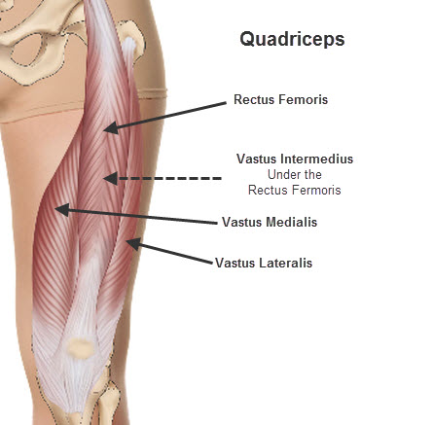
Rectus Femoris
(Vastus Intermedius) under RF
Vastus Medialis
Vastus Lateralis

Slide 49
1.21 Describe common diseases and disorders of each body system (prevention, pathology, diagnosis, and treatment)

Slide 50
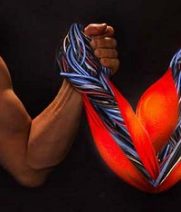
Muscle Disorders
Spasms
Cramps
Muscle spasm- when A muscle (or even a few fibers of a muscle) involuntarily contract
Muscle cramp- involuntarily + forcibly contracted muscle that does not relax
A forceful + sustained spasm
Nick named charley horse
Muscle feels tied up in knots
Can last anywhere from a few seconds to a quarter of an hour
Caused by strain or injury
Notes:
http://www.medicinenet.com/muscle_cramps/article.htm http://www.abc.net.au/science/news/img/techno/muscle170304.jpg http://www.cartoonstock.com/newscartoons/cartoonists/bgr/lowres/bgrn692l.jpg

Slide 51
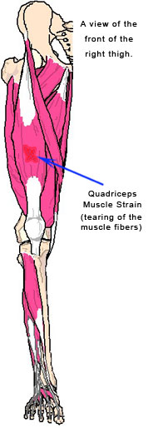
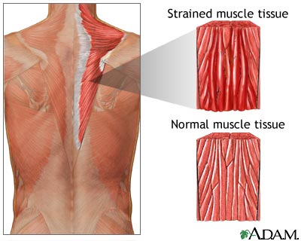
Muscle Disorders
Strain
A strain is an injury to a muscle or tendon, and is often caused by overuse, force, or stretching.
Injured area experiences:
pain and soreness
swelling
warmth, bruising, or redness
difficulty using or moving the injured area in a normal manner
Notes:
http://medicalimages.allrefer.com/large/muscle-strain.jpg http://www.ptclinic.com/medlibrary/images/a15a.jpg

Slide 52
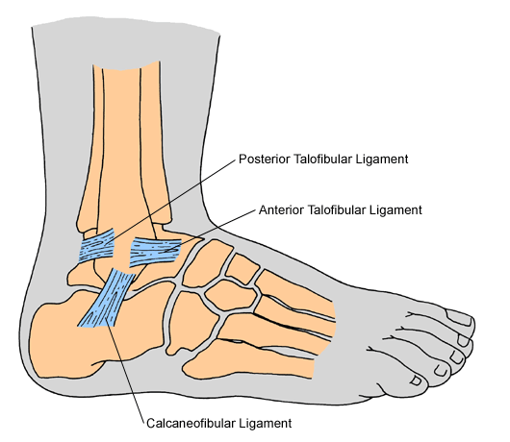
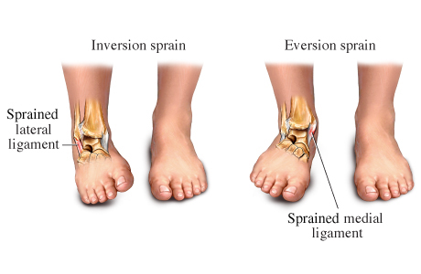
Muscle Disorders
Sprain
A sprain is a wrenching, twisting or stretching injury to a ligament.
Sprains often affect the ankles, knees, or wrists.
Result in pain, swelling, redness, bruising, and difficulty using injured joint.
Notes:
http://images.google.com/imgres?imgurl=http://health.yahoo.com/media/healthwise/n5551870.jpg&imgrefurl=http://health.yahoo.com/topic/emergency/overview/article/healthwise/popup/zm2754&h=300&w=460&sz=77&hl=en&start=8&um=1&tbnid=DDL4EAjN_AID7M:&tbnh=83&tbnw=128&prev=/images%3Fq%3Dsprains%26svnum%3D10%26um%3D1%26hl%3Den%26rls%3DGGLB,GGLB:1969-53,GGLB:en%26sa%3DN http://images.google.com/imgres?imgurl=http://healthcare.utah.edu/healthinfo/images/ei_0190.gif&imgrefurl=http://healthcare.utah.edu/healthinfo/pediatric/poison/sprains.htm&h=460&w=530&sz=38&hl=en&start=2&um=1&tbnid=7URgDVBTmf9H5M:&tbnh=115&tbnw=132&prev=/images%3Fq%3Dsprains%26svnum%3D10%26um%3D1%26hl%3Den%26rls%3DGGLB,GGLB:1969-53,GGLB:en%26sa%3DN

Slide 53
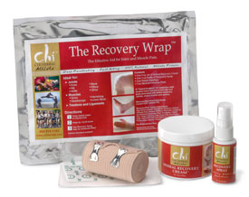
Muscle Disorders
Treatment for Muscle Injuries
R.I.C.E.
Rest: Stop all activities which cause pain.
Ice: Helps reduce swelling. Never ice more than 10-15 min. at a time. Protect the skin.
Compression: Wrap the strained area to reduce swelling.
Elevation: Keep the strained area as close to the level of the heart as is conveniently possible to keep blood from pooling in the injured area.

Slide 54
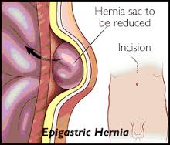
Muscle Disorders
Hernia-when an organ protrudes through a weak muscle
Notes:
http://www.humanillnesses.com/original/images/hdc_0001_0002_0_img0181.jpg

Slide 55
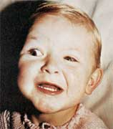
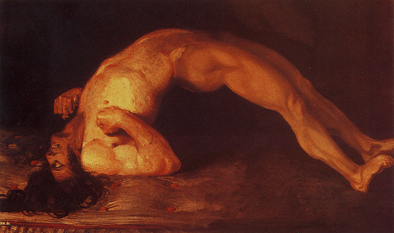
Muscle Disorders
Tetanus
Tetanus is a preventable disease through vaccination
Caused by bacteria that enters the body through the skin
Found in soil, dust and manure
Toxin bacteria produces interferes with nerve
transmission to your muscles and causes them to seize up in painful spasms.
Tetanus typically starts in the jaw and muscles of the face, quickly spreading to the arms and legs.
“Lockjaw”
Difficulty swallowing
Intestines often seize up
Bladder fails to empty
Asphyxiation
Cardiac arrest
Notes:
http://drfleablog.blogspot.com/2006/12/risus-sardonicus.html http://www.bilkent.edu.tr/~bilheal/aykonu/ay2005/mart05/SoldierTetanus.gif

Slide 56
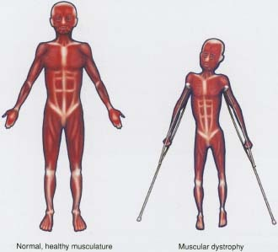
Muscle Disorders
Muscular Dystrophy
Muscular Dystrophy- most well known of hereditary diseases
A genetic condition that describes over 20 genetic and hereditary muscle diseases.
Characterized by progressive skeletal muscle weakness, defects in muscle proteins, and the death of muscle cells and tissue.
In some cases, cardiac and smooth muscles are affected.
Principal symptoms:
Progressive Muscular Wasting (weakness)
Poor Balance and Frequent Falls
Walking Difficulty + Waddling Gait
Limited Range of Movement
Scoliosis (curvature of the spine)
Inability to Walk
Muscle Atrophy and Drooping Eyelids
Notes:
http://www.humanillnesses.com/original/images/hdc_0001_0002_0_img0181.jpg

Slide 57
Muscle Disorders
Myalgia
Term that describes muscle pain
Fibromyalgia-Is a collection of symptoms.
Chronic muscle pain lasting 3 or more months in specific muscle points.
Headache, numbness, tingling, joint pain
DX: Rule out-
TX: pain relief, exercise, chiropractic procedures, relaxation techniques, stretching
PX: chronic life long condition with no single, complete cure
Notes:
http://www.humanillnesses.com/original/images/hdc_0001_0002_0_img0181.jpg

Slide 58
Muscle Disorders
Dystonia
Characterized by involuntary muscle contractions that cause repetitive movements or abnormal postures.
Cause- unknown
There are several types:
Torticollis
Blepharospasm
Craniofacial
TX- botox injections can sometimes be effective.
Notes:
http://www.humanillnesses.com/original/images/hdc_0001_0002_0_img0181.jpg

Slide 59
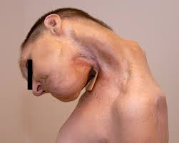
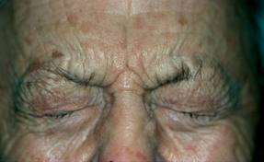
Muscle Disorders
Dystonia
Blepharospasm- involuntary and sustained contractions of the muscles around the eyes
Torticollis is a fixed or dynamic
tilt, rotation, or flexion of the
head and/or neck
Craniofacial Dystonia https://www.youtube.com/watch?v=44NYsYPCEMQ
Notes:
http://www.humanillnesses.com/original/images/hdc_0001_0002_0_img0181.jpg

Slide 60
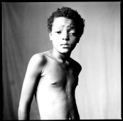
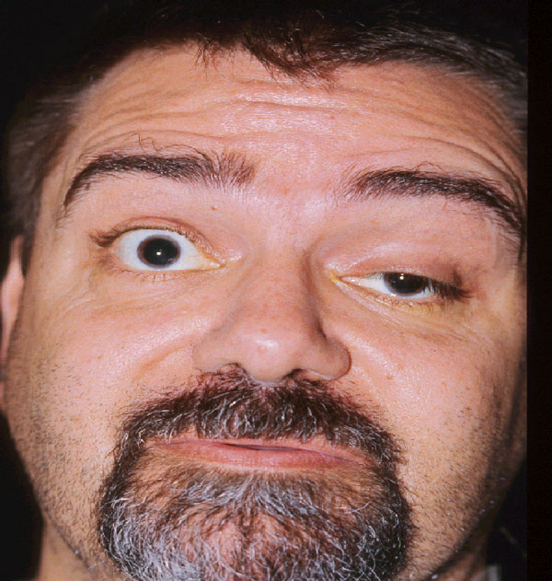
Muscle Disorders
Myasthenia Gravis
Myasthenia gravis- chronic autoimmune neuromuscular disease characterized by varying degrees of weakness of the skeletal muscles
Caused by a defect in the transmission of nerve impulses at the neuromuscular junction
Antibodies (produced by the body's own immune system) block, alter, or destroy the receptors for acetylcholine at the neuromuscular junction which prevents the muscle contraction from occurring.
The characteristic symptom of myasthenia gravis is fatigability, which means that a muscle that is used repeatedly starts to become weak.
The symptoms usually start in the face and spread to the other parts of the body as the disease progresses.
Certain muscles such as those that control eye and eyelid movement, facial expression, chewing, talking, and swallowing are often involved
The muscles that control breathing and neck and limb movements may also be affected.
Patients initially complain of drooping eye lids that get worst as the day goes on; they develop double vision, difficulty talking, and difficulty chewing.
Muscle weakness increases during periods of activity and improves after periods of rest.
Notes:
http://www.bmm.charite.de/rueckschau/ribeiro/Myasthenia%20gravis.jpg http://images.google.com/imgres?imgurl=http://www.nanosweb.org/patient_info/brochures/images/mythenia_1.jpg&imgrefurl=http://www.nanosweb.org/patient_info/brochures/MyastheniaGravis.asp&h=631&w=600&sz=98&hl=en&start=13&um=1&tbnid=ExsNh5GEE7ifoM:&tbnh=137&tbnw=130&prev=/images%3Fq%3DMyasthenia%2BGravis%26svnum%3D10%26um%3D1%26hl%3Den%26rls%3DGGLB,GGLB:1969-53,GGLB:en%26sa%3DN

Slide 61
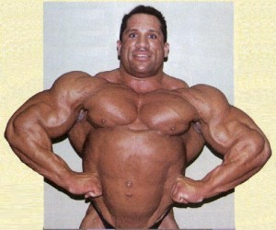
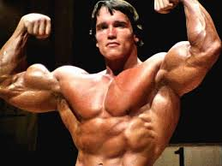
Muscle Disorders
Anabolic Steroids
Produced naturally by the body to support such functions as fighting stress and promoting growth and development
Referred to as roids, juice, hype, weight trainers, gym candy, arnolds, stackers, or pumpers
People use steroid pills, gels, creams, or injections to improve their sports performance or the way they look.

Slide 62
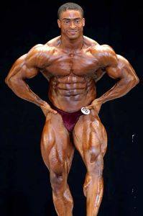
Muscle Disorders
Anabolic Steroids
types of problems
premature balding or hair loss
dizziness
mood swings
problems sleeping
nausea and vomiting
high blood pressure
aching joints
urinary problems
shortening of final adult height
increased risk of heart disease, stroke, and some cancers

Slide 63
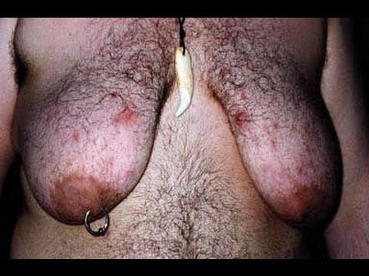
From Steroid abuse

Slide 64
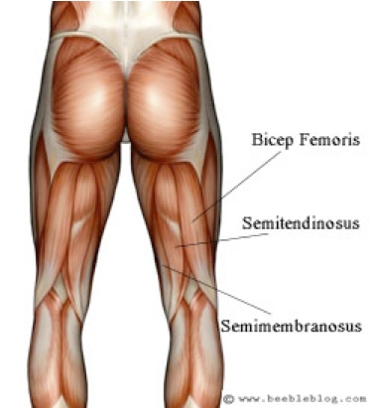

Slide 65
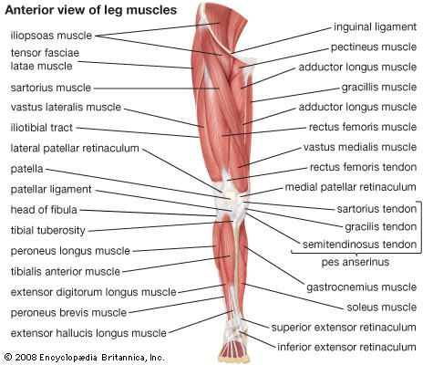

Slide 66
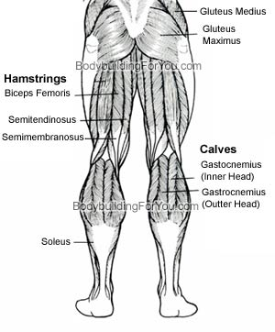

Slide 67
http://quizlet.com/1915732/muscles-of-the-head-and-neck-flash-cards/
http://quizlet.com/4596370/ap-muscle-test-flash-cards/
http://www.anatomyarcade.com/games/PAM/PAM.html
http://www.getbodysmart.com/ap/muscularsystem/menu/menu.html
http://www.getbodysmart.com/ap/muscularsystem/menu/menu.html

