Slide 1
Healthcare
Communication Skills

Slide 2
What is communication?
Communication
  A process by which information is exchanged between individuals though a common system of symbols, signs, or behavior

Slide 3
What is the Purpose of Communication?
Establish and maintain relationships
To persuade and change attitudes or behavior
Develop an understanding of other people
Problem solve

Slide 4
Healthcare Communication
Identify the elements of communication in this illustration.
Notes:
Teacher Notes:
The sender is likely a home health nurse or hospice volunteer.
The receive is the patient.
The message includes an element of caring and encouragement – evidenced by the touch and smile.
The feedback is acceptance and/or agreement by the patient, who appears to be smiling at the healthcare worker.

Slide 5
Modes of Communication
Verbal- speaking words
  Voice tone/pitch/volume
  Intonation
    whiney/sarcastic/sad
  Word Choice
    slang, friends, school, adult
Nonverbal
  Eye contact
  Body language, facial expressions, gestures
Written communication

Slide 6
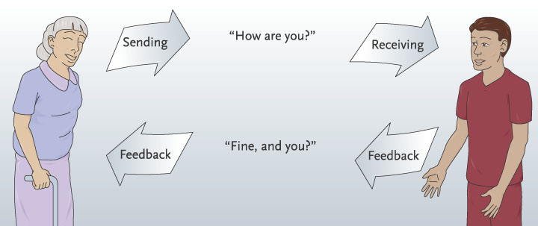
3 essential elements:
Sender
Individual who creates a message to convey information or ideas to another person
Message
Information, idea or thought
Receiver
Individual who receives the message from the sender
Feedback is a method that can be used to determine if communication was successful.
Occurs when the receiver responds to the message
Allows the original sender to evaluate how the message was interpreted and to make any necessary adjustments or clarification.
Feedback can be verbal or non-verbal.

Slide 7
Elements of Communication
Sender Receiver
Feedback
Channel- the route by which the message is sent (is it verbal or non-verbal?)
Interference- anything that changes the meaning of an intended message
Message
Notes:
Teacher Notes:
Describe the elements of the communication model.

Slide 8
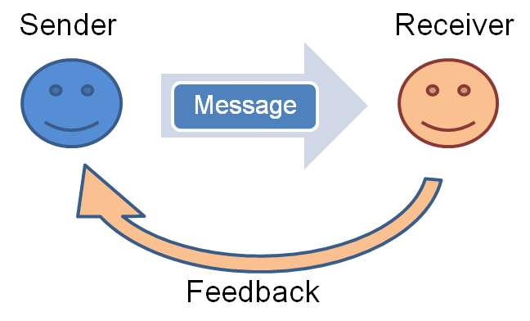
Communication Model Questions
What could happen to block any of the elements of communication?
Is the message always verbal?
Is the feedback always verbal?
What interruptions or distractions could interfere with communication?
Notes:
Teacher Notes:
First question – have students give examples of situations that would block any of the elements of communication. Pages 86-88 in Diversified Health Occupations, 7th edition, contains a number of examples.

Slide 9
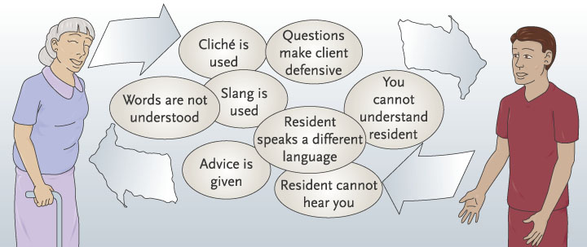
Barriers to communication
Something that gets in the way of clear communication
Three common barriers:
  Physical disabilities
  Psychological attitudes/prejudice
  Cultural diversity

Slide 10
Barriers (continued)
Physical disabilities
Psychological
Deafness/hearing loss
Blindness/impaired vision
Aphasia/speech impairments
Caused by prejudice, attitudes and personality
  Moralizing
  Lecturing
  Over-reacting
  Arguing
  Prejudging
  Advising

Slide 11
Barriers (continued)
Cultural Diversity
  Beliefs regarding health care
  Language differences
  Eye contact
  Ways of dealing w/ terminal illness and/or severe disability
  Touch
Heavy Medication

Slide 12
How Can We Have Effective Communication?
Health care workers must learn to put barriers aside and show respect to all individuals.
We must learn to see beyond the surface to the human beings underneath.
We must adjust our communication styles so that patients can understand.

Slide 13
Effective Communication
Developing skills in communication helps you become a better healthcare worker.
It is important always to be courteous and understanding (polite and considerate towards others).
Take time to evaluate gestures, facial expressions, and tone of voice in order to understand what is really being said.
  You must attempt to understand and to listen.

Slide 14
Rules for Effective Communication
Message must be clear
Sender must deliver message clearly and concisely
Receiver must be able to hear and receive the message
Receiver must be able to understand the message
Interruption or distractions must be avoided
Notes:
Teacher notes:
This slide summarizes the key points of the communication model.

Slide 15
Listening
Essential part of effective communication.
Paying attention to and making an effort to hear what the other person is saying.
Requires constant practice.
Being a good listener makes you a better health care worker.

Slide 16
Listening
Good listening skills:
  Show interest and concern for what the speaker is saying.
  Be alert and maintain eye contact with the speaker.
  Avoid interrupting the speaker.
  Pay attention to what the speaker is saying.
  Avoid thinking about how you are going to respond.

Slide 17
Listening
  Try to eliminate your own prejudices and see the other person’s point of view.
  Eliminate distractions by moving to a quiet area for the conversation.
  Watch the speaker closely to observe actions that may contradict what the person is saying.
  Reflect statements back to the speaker to let the speaker know that statements are being heard.

Slide 18
Listening
  Ask for clarification if you do not understand part of a message.
  Keep your temper under control and maintain a positive attitude.
Good listening skills also help you follow directions, make good observations of patients, and understand your fellow workers.

Slide 19
Active Listening Skills
Reflect on what the sender is trying to say – think about the message, not just your response.
Restate (paraphrase) back to the sender to let them know they are being heard and understood.
Ask for clarification if you do not understand part of the message.
Request examples to help explain or clarify meaning.
Use questioning to find out more information.

Slide 20
Obtaining Feedback
Respond to this call to a veterinary office from a pet owner.
Paraphrasing
Reflecting
Asking questions
Requesting examples
I need to make an appointment for my dog. She’s not doing very well.
Notes:
Teacher notes;
Ask students to imagine themselves as a receptionist at a Veterinary office. Have them give examples of each type of feedback.

Slide 21
Communication
Why is this important to us as health care workers?

Slide 22
Nonverbal Communication
It is not necessary to speak in order to send a message.
Health care workers need to be aware of both their own and patients’ nonverbal behaviors because these are an important part of any communication process.
When verbal and nonverbal messages agree, the receiver is more likely to understand the message being sent.

Slide 23
Nonverbal Communication
Eye Contact
  Lets others know that you are paying attention.
Facial Expressions
  Ex: smile, frown.
  Make sure that the verbal message matches your facial expression.

Slide 24
Nonverbal Communication
Gestures
  Motions of a part of the body to express feelings or emotions.
  Ex: shrugging your shoulders, turning your back, leaving the room while someone is talking – convey lack of interest.
Touch
  Can convey great caring and concern or rejection and anger.
  Touch can convey more interest and caring than words could ever do.

Slide 25
Nonverbal Communication
Space
  The amount of distance put between a person and others
Influences
  Status
  Culture
  Content of interaction
  Gender
  Age

Slide 26
Nonverbal Communication
Artifactual communication
  Clothing
  Body adornments
  Possessions which are used to communicate information about age, gender, status, personality, and relationships
    Clothing
    Hair style
    Bookbags

Slide 27
Nonverbal Communication
Touch
  One of the most personal and powerful means of communication
The meaning depends on
  Type of touch
  The situation in which the touch occurs
  Who is doing the touch
  The cultural background of those involved
Appropriateness of touch
Touch avoidance
Touch and the healing process

Slide 28
Nonverbal Communication
Constantly occurring
More believable than verbal communication
Primary means of expression
  Almost all feelings and attitudes are expressed through nonverbal behaviors

Slide 29
Paraliguistics
What is paralanguage?
optional vocal effects (as tone of voice) that accompany or modify the phonemes of an utterance and that may communicate meaning
http://www.esl-lab.com/para.htm

Slide 30
Reflection:
How might understanding non-verbal communication benefit you in the health care field?

Slide 31
Written Communication
Documentation

Slide 32
Recording and Reporting
In health care, an important part of effective communication is reporting or recording all observations while providing care.
Your ability to observe patient behavior and symptoms will directly affect their care.

Slide 33
Documentation
A record of the patient’s progress throughout treatment. Purpose is to record patient care and prove accountability for care given
Many people are responsible for documenting information on patients.
Documentation must be accurate, concise, and complete.
  Writing should be neat and legible.
  Spelling and grammar should be correct.

Slide 34
Documentation
All records must contain certain information:
  Patient name, address, age, identification #.
  Diagnosis and physician’s orders.
Other information may be required:
  Care or treatment given and how patient tolerated it.
  Time of treatment.
  Observations that would be helpful to other health care workers.

Slide 35
Documentation
All documentation must be signed with the name and title of the person recording the information.
Errors should be crossed out neatly with a straight line, have “error” recorded by them, and show the initials of the person making the error. Never use ‘white out’!
Never skip lines! Write under the previous documentation.
Patient documentation is a legal record, admissible in a court of law.

Slide 36
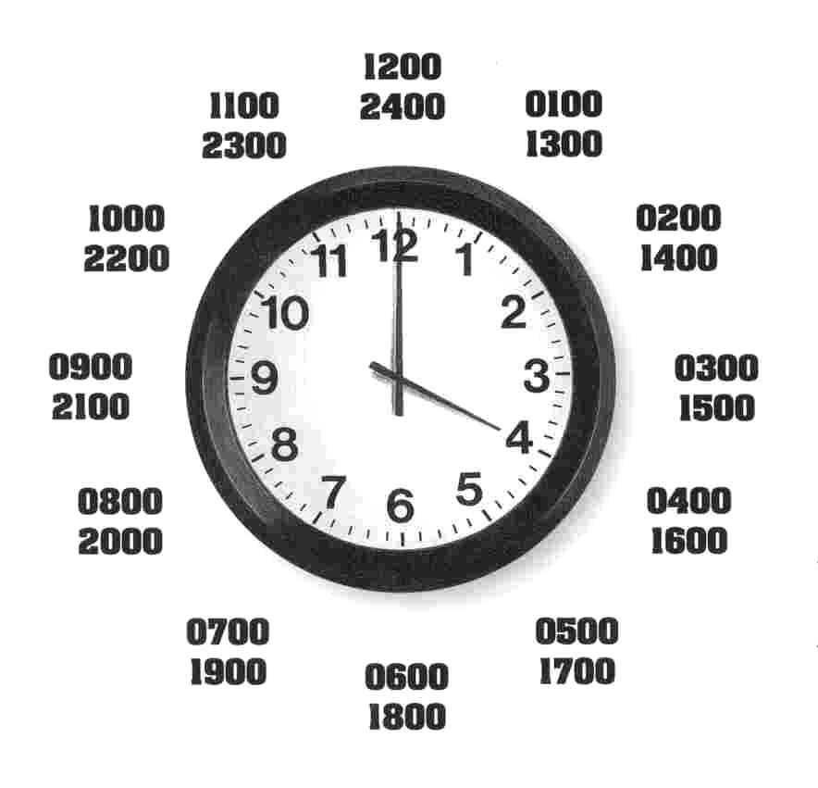
Documentation
If you do not write it down, it did not happen!
Use blue or black (depending on your facility policy) ink for all documentation.
Entries should be in short phrases. You do not need to write in complete sentences.
Time should be recorded in military (24 hour) time.

Slide 37
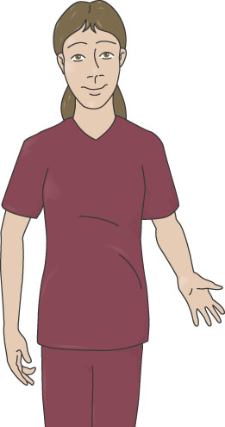
Recording & Reporting
Must record and report all observations while providing care
Must listen to what patient is saying, but observe with other senses as well
You must ALWAYS record objective observations! If there is subjective information that needs to be recorded, it MUST be in quotations or c/o

Slide 38
Healthcare Information can be Subjective or Objective
Subjective
  Cannot be seen or felt
  Often called symptoms
  Usually statements or complaints from the patient
  Use the patient’s exact words
Notes:
Teacher Notes:
The next 5 slides will help students learn the difference between objective and subjective information.

Slide 39
Healthcare Information can be Subjective or Objective
Objective
  Can be seen or measured
  Often called signs
  Information collected by the senses

Slide 40
Subjective Symptoms
I think I’m gonna throw up.
My tummy hurts.
It’s really sore on my chest.
I don’t feel very good.

Slide 41
Objective Signs of Illness
Pulse rapid, irregular and thready
Skin cold and clammy
No respirations
Lips cyanotic

Slide 42
Subjective or Objective?
Coughing
Fatigue
Headache
Foul smelling breath
Did not eat anything
Speech slurred
Joints ache
Nervousness
Objective
Subjective
Subjective
Objective
Objective
Objective
Subjective
Subjective
Notes:
Teacher Notes:
This slide gives you the opportunity to determine if students know the difference between objective and subjective information. You can have them write their answers on scratch paper before revealing the correct response. Recognize those students who answer all 8 correctly.

