Slide 1
RESPIRATORY SYSTEM
LUNGS & AIR PASSAGES

Slide 2
Function:
TAKE IN OXYGEN
GAS NEEDED BY ALL BODY CELLS
REMOVING CARBON DIOXIDE
GAS THAT IS A WASTE PRODUCT PRODCUED BY THE CELLS

Slide 3
HOW MUCH O2 DO WE HAVE?
FOUR TO SIX MINUTES SUPPLY

Slide 4
RESPIRATORY SYSTEM
MUST WORK CONTINOUSLY OR DEATH WILL OCCUR

Slide 5
RESPIRATORY SYSTEM
NOSE
PHARYNX
LARYNX
TRACHEA
BRONCHI
ALVEOLI
LUNGS

Slide 6
NOSE
TWO NOSTRILS (NARES)
OPENINGS WHICH AIR ENTERS

Slide 7
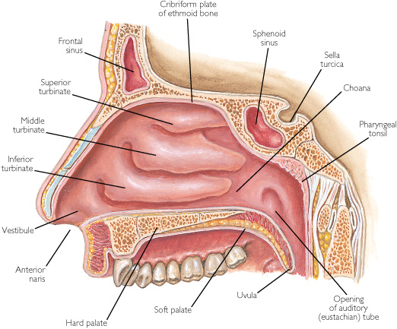
NASAL CAVITY
TWO HOLLOW SPACES
LINED WITH A MUCOUS MEMBRANE
RICH BLOOD SUPPLY
WARMS AIR
FILTERS AIR
MOISTENS AIR

Slide 8
CILIA
TINY HAIRLIKE STRUCTURES IN NASAL CAVITY
TRAPS DIRT
TRAPS PATHOGENS
TRAPPED PARTICLES PUSHED TOWARD ESOPHAGUS
SWALLOWED

Slide 9
PHARYNX
THROAT
LOCATED BEHIND THE NASAL CAVITIES
AIR LEAVES NOSE & ENTERS PHARYNX

Slide 10
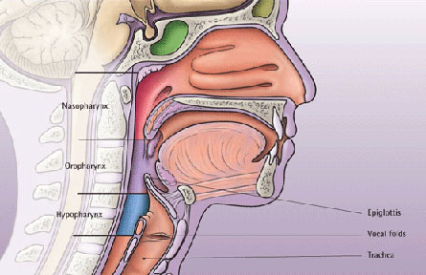
THREE SECTIONS OF THE PHARYNX
NASOPHARYNX
OROPHARYNX
LARYNGOPHARYNX

Slide 11
LARYNGOPHARYNX
BOTTOM SECTION OF PHARYNX
BRANCHES INTO
TRACHEA
CARRIES AIR TO AND FROM THE LUNGS
ESOPHAGUS
CARRIES FOOD TO STOMACH

Slide 12
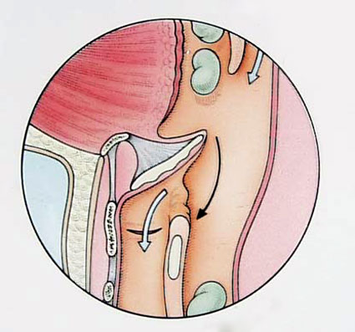
LARYNX
EPIGLOTTIS
PIECE OF CARTILAGE
LEAF LIKE STRUCTURE
CLOSES THE OPENING INTO LARYNX DURING SWALLOWING
PREVENTS FOOD & LIQUIDS FROM ENTERING RESPIRATORY TRACT

Slide 13
EPIGLOTTIS

Slide 14
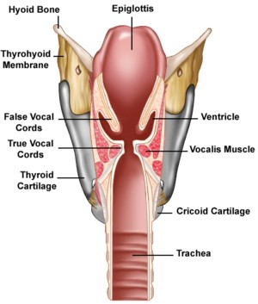
LARYNX
VOICE BOX
BETWEEN THE PHARYNX & TRACHEA
CARTILAGE CALLED
ADAM’S APPLE

Slide 15
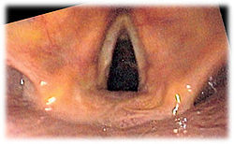
LARYNX
VOCAL CORDS
TWO FOLDS
OPENING BETWEEN VOCAL CORDS
GLOTTIS
AIR ENTERS LUNGS
VOCAL CORDS VIBRATE
PRODUCE SOUND OR SPEECH

Slide 17
TRACHEA OR WINDPIPE
TUBE EXTENDING FROM LARYNX TO CENTER OF CHEST
CARRIES AIR BETWEEN PHARYNX & BRONCHI
SERIES OF C-SHAPED CARTILAGE
OPEN ON THE DORSAL SURFACE
HELPS KEEP TRACHEA OPEN

Slide 18
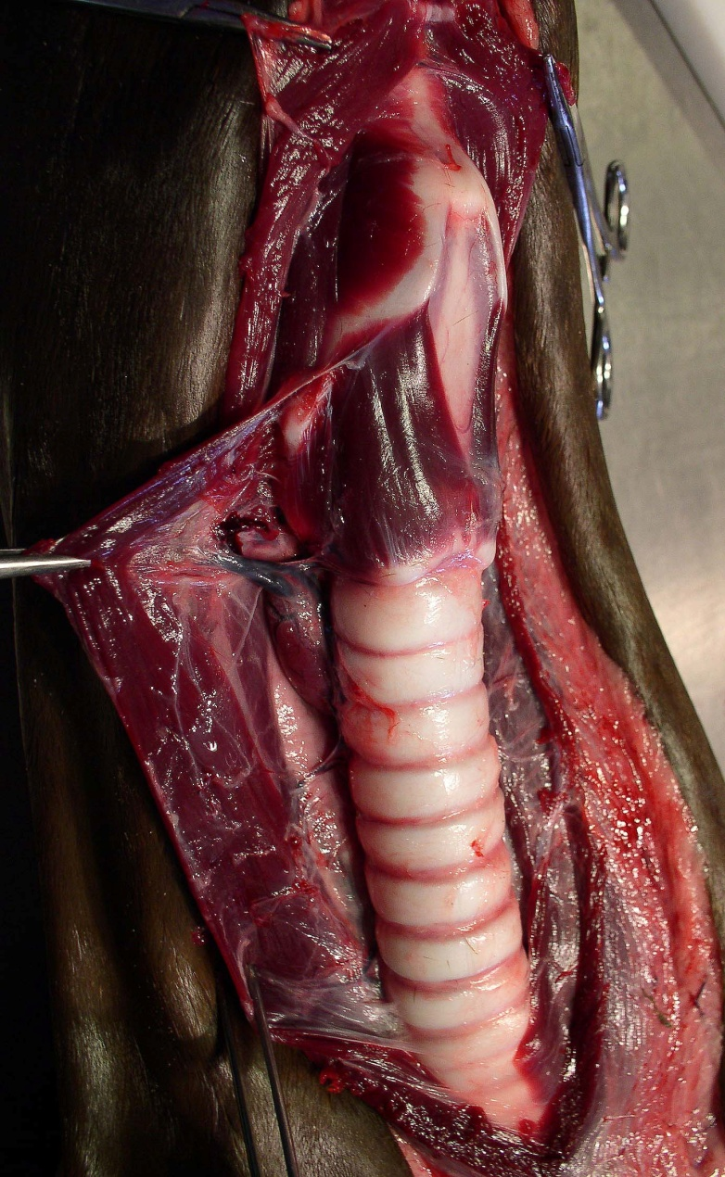
TRACHEA OR WINDPIPE

Slide 19
BRONCHI
TWO DIVISIONS OF TRACHEA
NEAR CENTER OF CHEST
BRONCHUS
ENTERS LUNG
CARRIES AIR
TRACHEA TO LUNGS
LUNGS
BRONCHI DIVIDE INTO SMALLER BRONCHI

Slide 20
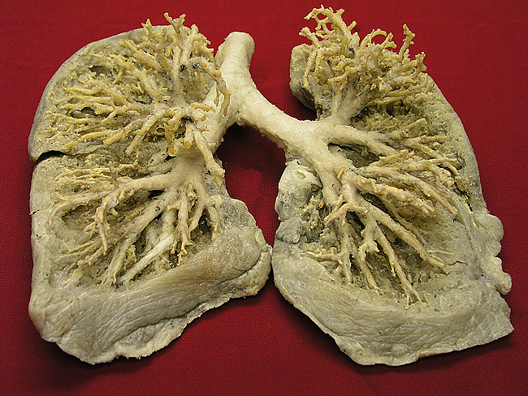
BRONCHI

Slide 21
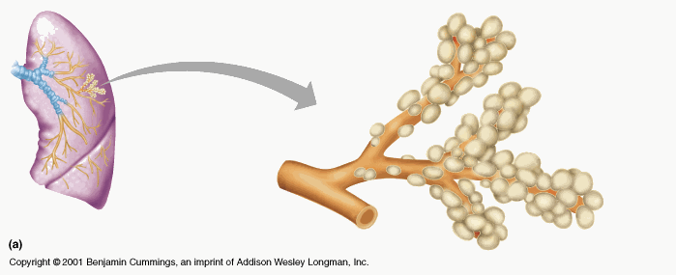
SMALLEST BRANCHES
BRONCHIOLES
END IN AIR SACS CALLED ALVEOLI

Slide 22
ALVEOLI
AIR SACS
RESEMBLE BUNCH OF GRAPES
ONE LAYER OF SQUAMOUS EPITHELIUM TISSUE
RICH NETWORK OF BLOOD CAPILLARIES
CAPILLARIES
ALLOW OXYGEN & CARBON DIOXIDE TO EXCHANGE BETWEEN LUNGS & BLOOD

Slide 23
ALVEOLI

Slide 24
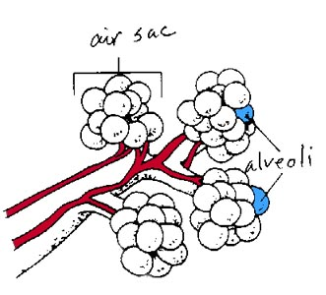
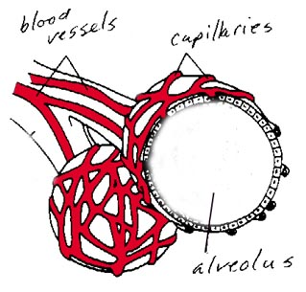
Diffusion
http://www.borg.com/~lubehawk/hrespsys.htm

Slide 25
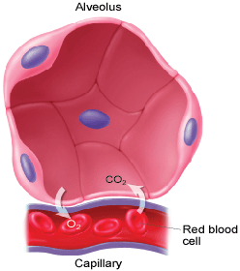
http://mhln.com

Slide 26
LUNGS
RIGHT LUNG
3 SECTIONS OR LOBES
SUPERIOR, MIDDLE & INFERIOR
LEFT LUNG
TWO LOBES
SUPERIOR & INFERIOR
SMALLER
HEART LIES MORE TO THE LEFT SIDE OF CHEST

Slide 27
LUNGS

Slide 28
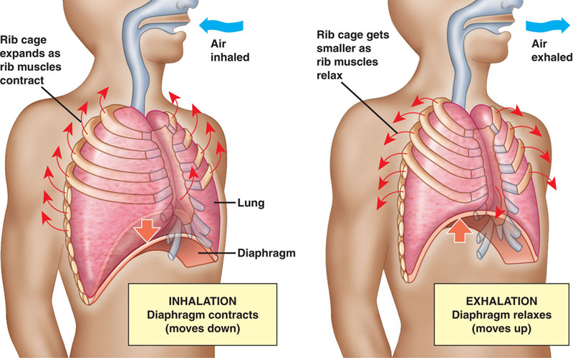
DIAPHRAGM

Slide 29
INTERCOSTALS

Slide 30
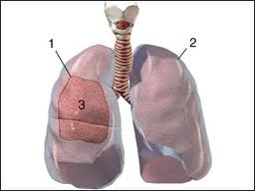
PLEURA
MEMBRANE OR SAC ENCLOSING EACH LUNG
THORACIC CAVITY
BOTH LUNGS
HEART
MAJOR BLOOD VESSELS

Slide 31
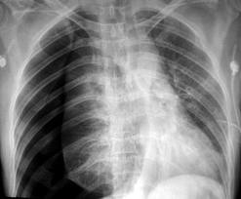
PNEUMOTHORAX-AKA: Blown lung or collapsed lung

Slide 32
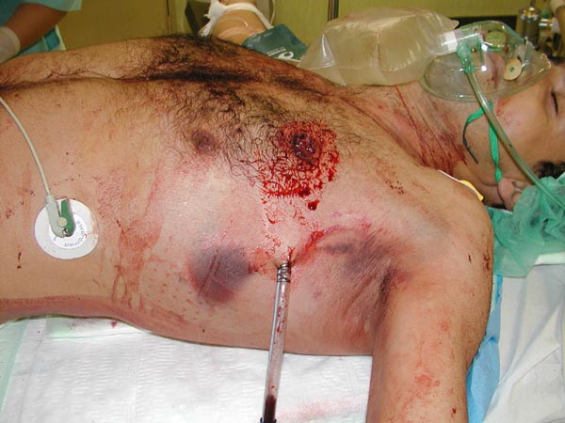
How do you fix it?
Chest tubes!

Slide 33
THE END

