Slide 1
Standard and Transmission-Based Precautions

Slide 2
Standard Precautions:
set of rules that were developed by the CDC.
Under these rules, every body fluid must be considered infectious
all patients should be considered as sources of infection.

Slide 3
Standard precautions must be used anywhere health care workers might come in contact with:
Blood
Body Fluids
Mucous Membranes
Non-intact Skin

Slide 4
There are Nine steps to standard precautions:

Slide 5

Wash Hands-
after touching blood
any type of body fluid
after gloves are removed
between patients.

Slide 6
Wear Gloves-
when touching body fluids
any contaminated items
always change gloves between tasks and procedures.
(WHEN IN DOUBT, USE GLOVES!)

Slide 7
Wear Masks and Eye Protection-
during procedures that are likely to generate sprays or splashes of body fluid.

Slide 8
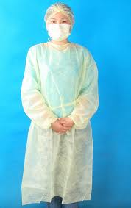
Wear Gowns-
to protect the skin and clothing during processes that are likely to generate sprays or splashes of body fluid.

Slide 9

Patient Care Equipment-
ensure that reusable equipment is cleaned appropriately before being used on another patient.
Use one patient use items when available.

Slide 10
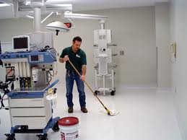
Environmental Control-
follow policies about cleaning and disinfection of beds , curtains, and other frequently touched surfaces.

Slide 11

Linen-
Handle, transport, and process linen soiled with blood or other body fluid in a way that prevents exposure and contamination of clothing, and avoids the transfer of pathogens to other patients and their environments.

Slide 12
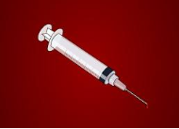
Occupational Health and Bloodborne Pathogens-
never recap or bend needles.
Always put needles and other sharp items into a red sharps box which is a puncture resistant container.

Slide 13
Patient Placement-
Use private rooms for patients that may contaminate the environment.

Slide 14
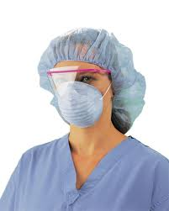
Gowns, gloves, masks, protective eye wear, face shields, shoe covers, and surgical caps are all considered PPE, or Personal Protective Equipment.

Slide 15
Transmission based precautions:

Slide 16
For patients who may have highly infectious diseases, other precautions may be needed. These are called transmission based precautions
There are four:
  Airborne precautions
  Droplet precautions
  Contact precautions
  Reverse isolation precautions

Slide 17
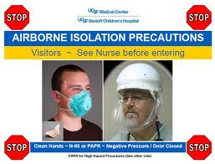
Airborne precautions:
diseases such as tuberculosis (TB) can be spread by tiny airborne droplets. The droplets can stay suspended in the air for long periods of time because they are so small.
In addition to standard precautions, the patient must also be in a special room with negative pressure.
The door must always remain closed.
Anyone entering the room must have on a high efficiency particulate air (HEPA) filter or mask.

Slide 18
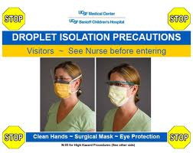
Droplet precautions:
used for patients known or suspected to be infected with pathogens that are transmitted by large droplets, such as meningitis and pertussis (whooping cough) and other diseases that can be spread when a client coughs or sneezes.
Masks must be worn when working within three feet of the patient.

Slide 19
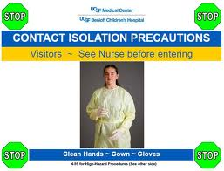
Contact precautions:
used for patients known or suspected to be infected with microbes that are spread easily by direct or indirect contact, such as MRSA, scabies, or pink eye.
Gloves and gowns should be worn when entering the room or when having any contact with the patient or any surfaces or items in the room.

Slide 20
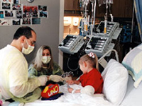
Protective or reverse Isolation-
Used to protect certain patients from microbes in the environment.
This is mainly for immunocompromised patients- burns, bone marrow transplants, and AIDS.
The patient is placed in a room that has been disinfected and frequent disinfection occurs while the patient is in the room. Anyone who enters the room must wear gowns, gloves, and masks.

Slide 21
OSHA stands for Occupational Safety and Health Administration

Slide 22

In 1991, OSHA established the Bloodborne Pathogen Standards that must be followed by all health care facilities. The facilities face severe penalties if the rules are not implemented by employers or not followed by employees.

Slide 23
These rules include:
Identify all employees who are exposed to blood or body fluids.
Provide a Hepatitis B shot free to all employees
Provide PPE in accessible locations
Provide adequate handwashing facilities
Ensure workplace is maintained in a clean and santitary condition.
Enforce rules of no eating, drinking, smoking or applying make-up in any area that could be contaminated with body fluids.

Slide 24
Provide adequate containers for all sharps and other infectious wastes.
Post signs at entrance to work areas where there is exposure risks.
Provide a confidential exam and follow-up for any employee who has an exposure incident (needle stick or splash in the eyes or mouth).
Provide yearly training about the regulations to all employees.

Slide 25

NOW STUDY!

Slide 26

Template Provided By
www.animationfactory.com
500,000 Downloadable PowerPoint Templates, Animated Clip Art, Backgrounds and Videos

