Slide 1
Chapter 20
Urinary System

Slide 2
Urinary System
Excretion of nitrogenous wastes, salts, and
water
Two kidneys
    Form the urine
Two ureters
One bladder
One urethra

Slide 3
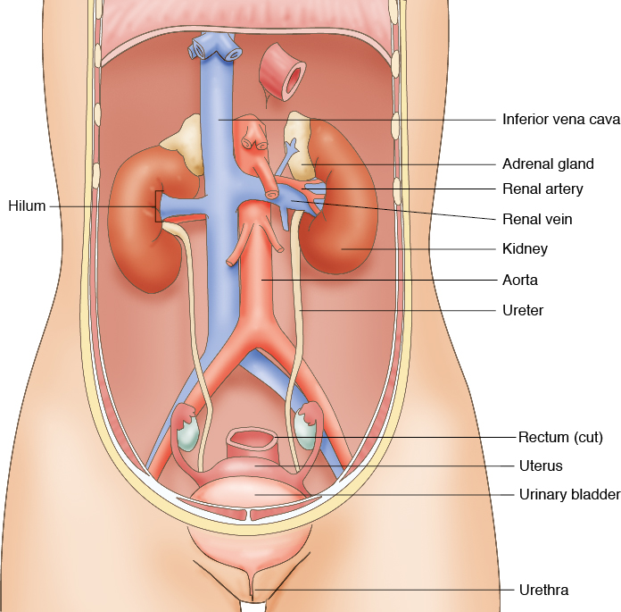
Urinary System Structures
© 2014 Cengage Learning.

Slide 4
Elimination of Waste
Products Summary
Lungs (exhalation)
    Carbon dioxide and water vapor
Kidneys (urination)
    Nitrogenous wastes and salts dissolved in water to form urine

Slide 5
Elimination of Waste
Products Summary
Skin (perspiration)
    Dissolved salts
Intestines (defecation)
    Solid wastes and water

Slide 6
Functions – Urinary System
Excretion
Aids in maintaining acid-base balance
Secretion of waste products in the form of
urine
Elimination of urine from the bladder where
it is stored

Slide 7
Kidneys
Located retroperitoneal
Adipose capsule
Renal fascia
Hilum
Renal pelvis
Medulla and cortex

Slide 8
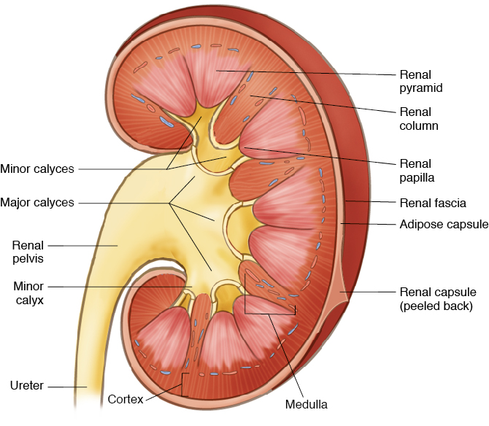
Kidneys
© 2014 Cengage Learning.

Slide 9
Nephron
Basic structural and functional unit
Each kidney has over 1 million
Afferent arteriole
Bowman’s capsule
Glomerulus
Proximal convoluted tubule

Slide 10
Nephron
Loop of Henle
Distal convoluted tubule
Collecting tubule
Efferent arteriole

Slide 11
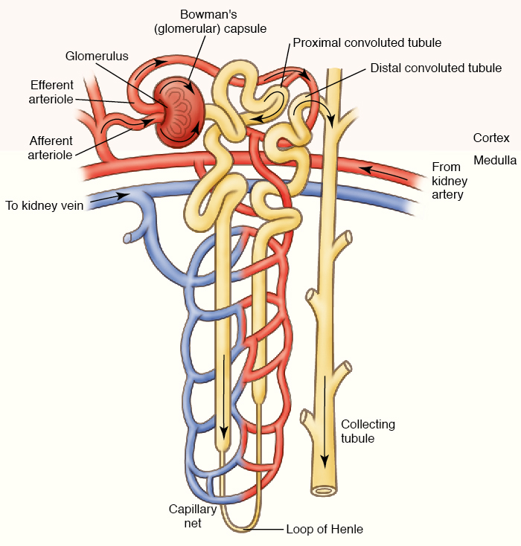
Nephron
© 2014 Cengage Learning.

Slide 12
Path of Urine Formation
Blood enters the afferent arteriole
Glomerulus
Bowman’s capsule
Becomes filtrate
Proximal convoluted tubule
Loop of Henle
Distal convoluted tubule

Slide 13
Path of Urine Formation
Collecting tubule
    At collecting tubule, approximately 99% of the filtrate has been reabsorbed
About 1 ml of urine is formed per minute
The 1 ml of urine goes to the renal pelvis
To the ureter bladder urethra urinary meatus

Slide 14
Urine Formation in the Nephron
Filtration
Reabsorption
Secretion
Urinary output and urinalysis values

Slide 15
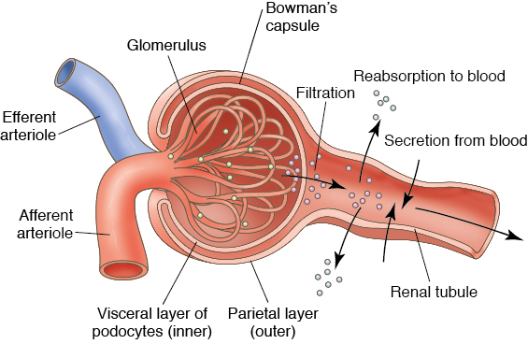
Urine Formation in the Nephron
© 2014 Cengage Learning.

Slide 16
Ureters
Two ureters
    One for each kidney
Carries urine to the bladder for storage
About 10-12 inches long and ¼-inch wide
Mucous membranes line ureters
Smooth muscle fibers
    Peristalsis to push urine down the ureter to the bladder

Slide 17
Urinary Bladder
Hollow muscular organ
Stores up to about 1 pint (500 ml) of urine
Involuntary contractions of the bladder can be controlled to some extent by the nervous system
Urine leaves the bladder through the urethra, then passes through the opening called the urinary meatus

Slide 18
Control of Urinary Secretion
Chemical control
Nervous control

Slide 19
Effects of Aging
Kidneys shrink
Changes result in decreased renal blood flow
Kidney compromised in removing waste
products
Decreased glomerular filtration rate
    Drug dosages have to be adjusted

Slide 20
Effects of Aging
Glucose reabsorption also decreases
    Hyperglycemia
Loss of muscle tone in the urinary bladder
Urinary incontinence

Slide 21
Disorders – Urinary System
Acute kidney failure
Chronic renal failure
Glomerulonephritis
Acute glomerulonephritis
Chronic glomerulonephritis

Slide 22
Disorders – Urinary System
Hydronephrosis
Pyelonephritis
Kidney stones or renal calculi
Cystitis
Incontinence
Neurogenic bladder

Slide 23
Dialysis
Used for kidney failure
Hemodialysis
Peritoneal dialysis

Slide 24
Kidney Transplants
Living donor transplant
Unrelated donor who has died
Major concern
    Rejection of kidney by the recipient
Medications taken daily to prevent rejection
Allows for better quality of life than dialysis

